Slide 1

Chapters 3 Energy Balances
Carnot engine, Carnot heat pump
Entropy
Work per cycle
Distillation systems
Ideal gas mixtures
Reacting systems, reaction coordinate
Heat of reaction

Slide 2
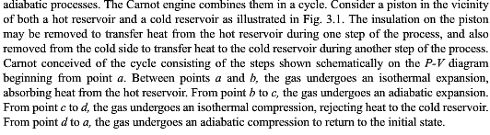
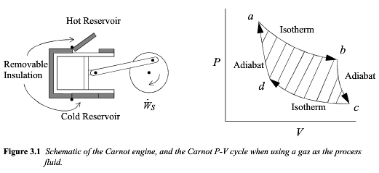

Slide 3
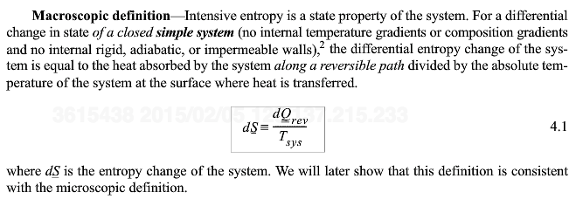
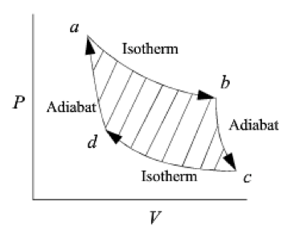
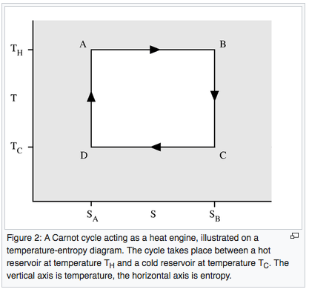

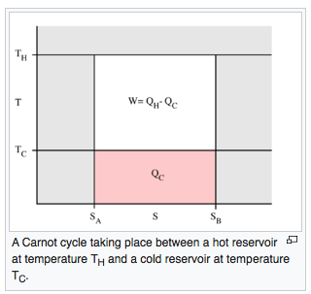

Slide 4
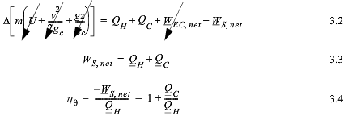
Shaded Area is W_{s}
Net W_{EC} = 0
For a Cyclic Process
LHS is 0
Q_{C}/Q_{H} Negative

Slide 5
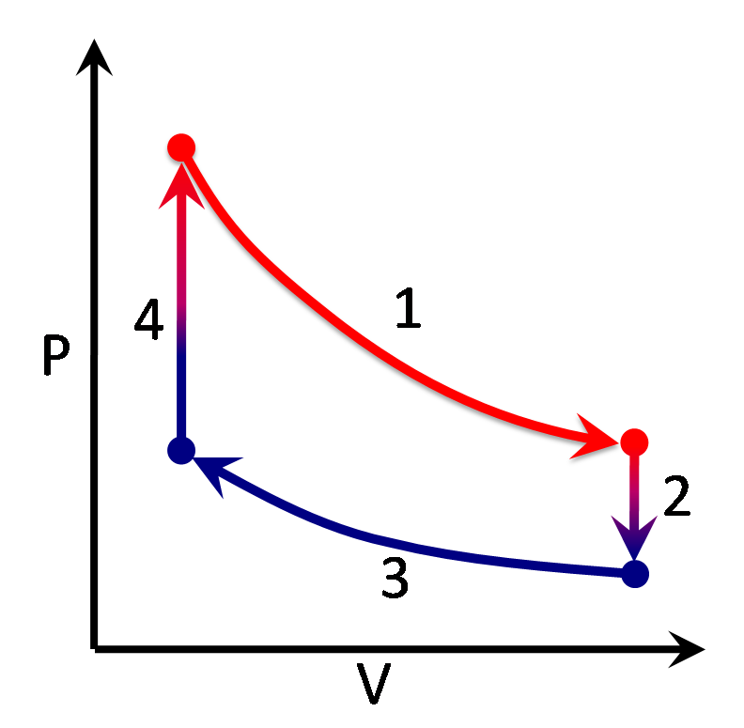

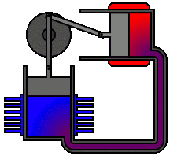
Sterling Engine
By Zephyris at the English language Wikipedia, CC BY-SA 3.0, https://commons.wikimedia.org/w/index.php?curid=3185502
By YK Times at English Wikipedia, CC BY 2.5, https://commons.wikimedia.org/w/index.php?curid=3088708

Slide 6

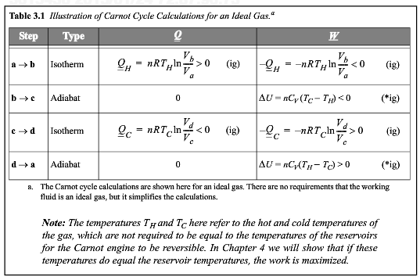
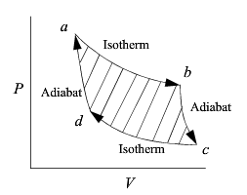
For the isotherms
a=>b and c=>d
Q = ΔS T
and ΔS_{ab} = -ΔS_{cd}
So Q_{C}/Q_{H} = -T_{C}/T_{H}

Slide 7
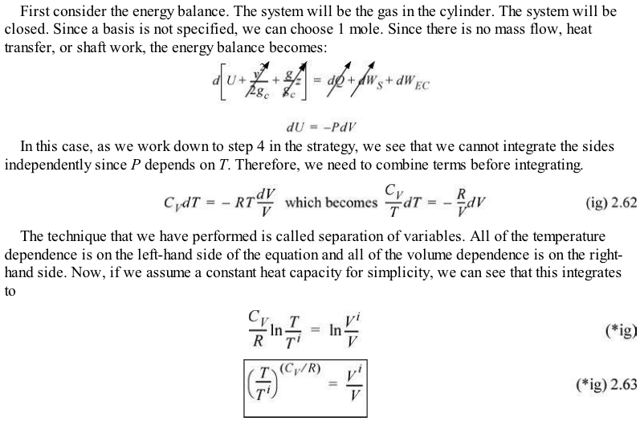
Adiabatic expansion for an ideal gas

Slide 8

For the isothermal segments ΔS = Q/T and S is a state function so Q₁/T₁ + Q₂/T₂ = 0. So Q₁/Q₂ = -T₁/T₂.

Slide 9


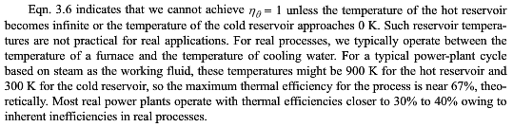

Slide 10
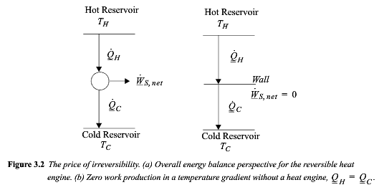

Slide 11
Carnot Heat Pump

Slide 12
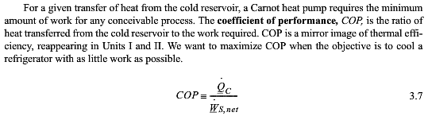
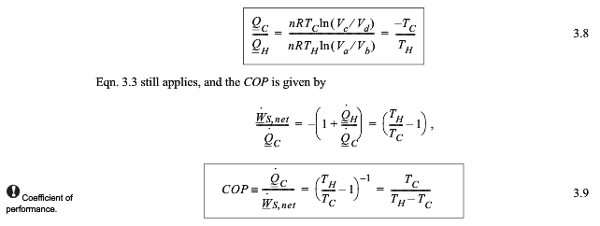
For the isotherms
a=>b and c=>d
Q = ΔS T
and ΔS_{ab} = -ΔS_{cd}
So Q_{C}/Q_{H} = -T_{C}/T_{H}

Slide 13
For the isotherms
a=>b and c=>d
Q = ΔS T
and ΔS_{ab} = -ΔS_{cd}
So Q_{C}/Q_{H} = -T_{C}/T_{H}

Slide 14
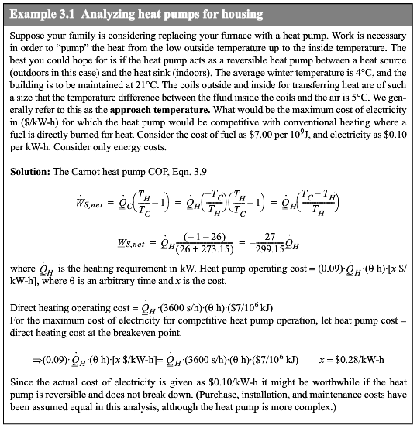

Slide 19
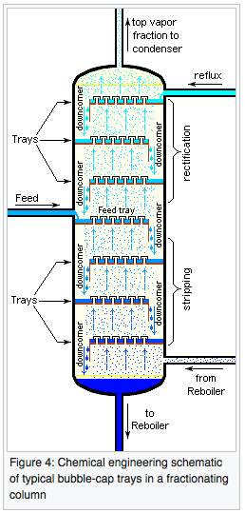
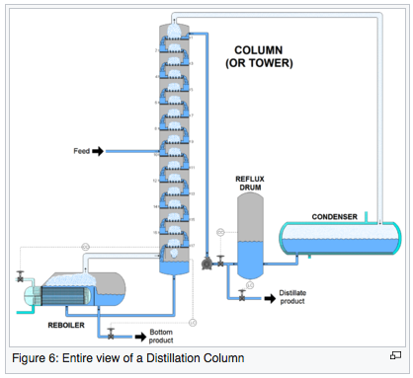
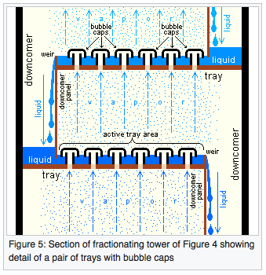
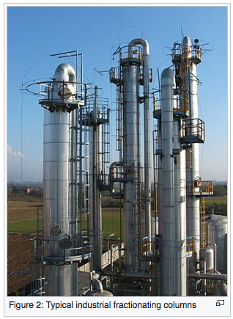
Distillation Column

Slide 20

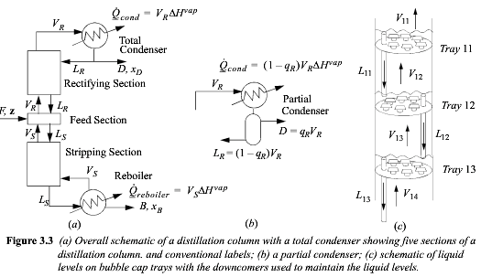

Slide 21
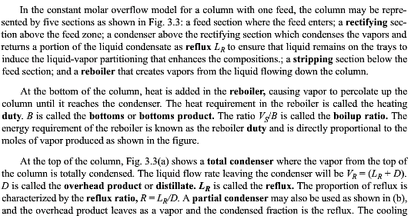
Feed zone
Rectifying section
Reflux L_{R}
Stripping section
Reboiler
Reboiler duty
Bottoms
Boilup ratio, V_{s}/B
Total condenser
Distillate D
Reflux LR
Reflux ratio R = L_{R}/D
Partial condenser (q)
Condenser duty

Slide 22
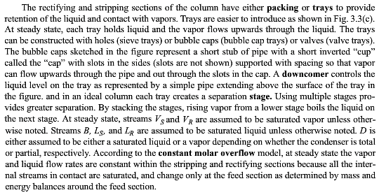
Packing
Trays
Sieve trays
Bubble cap trays
Valve trays
Downcomer
Stage
Streams:
VS,VR,LS,LR,B,D
Constant molar overflow
Equal liquid flow rates
Average vaporization
enthalpy

Slide 23
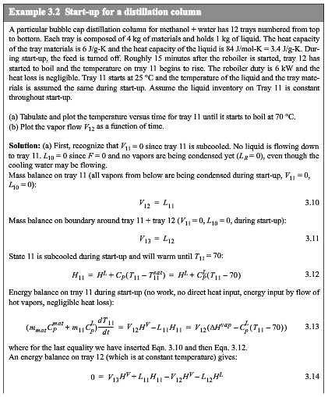

Slide 24
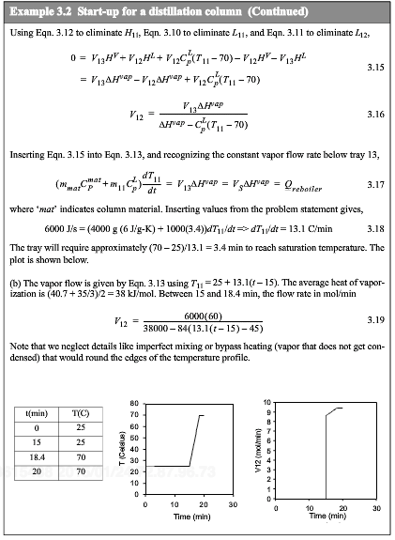

Slide 25


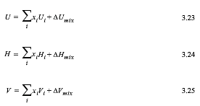

Slide 26
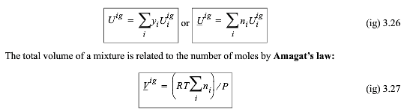



Slide 27






Slide 28
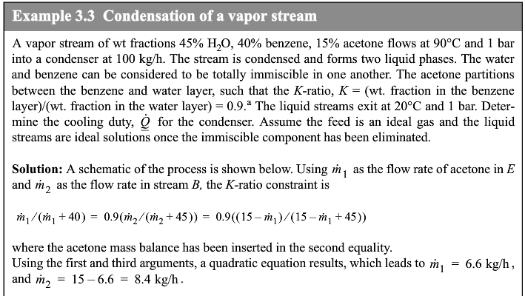
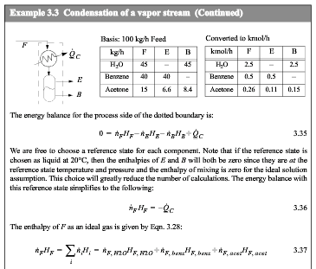

Slide 29
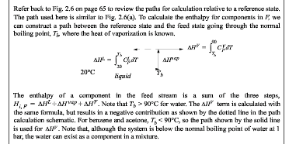
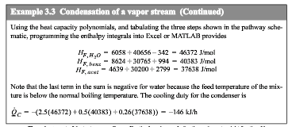

Slide 30







Slide 31
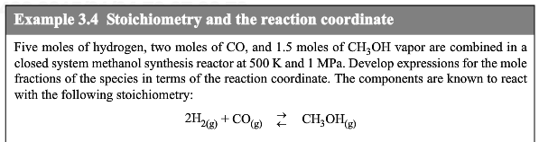
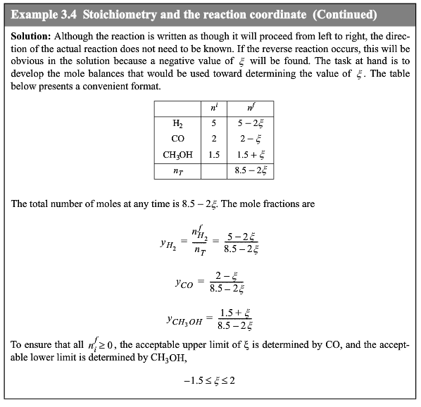

Slide 32
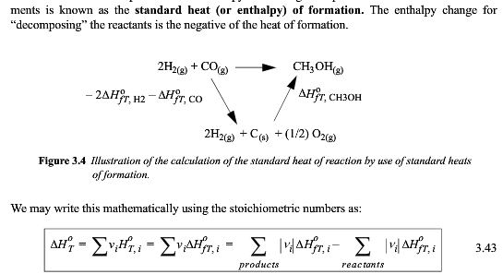

Slide 33



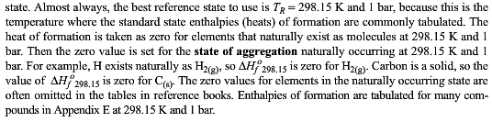

Slide 34
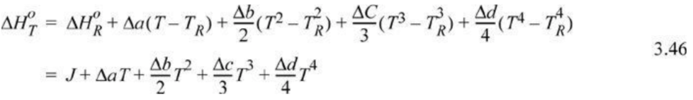

Standard Heat of Reaction ΔH⁰_{T}

Slide 35


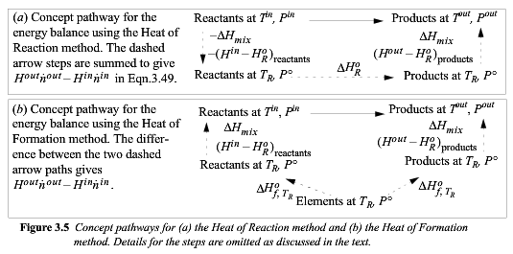

Slide 36
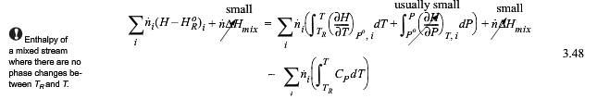
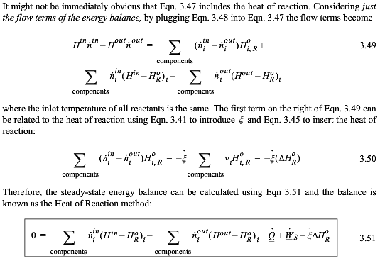

Slide 37
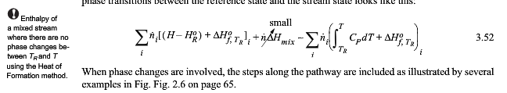

Slide 38
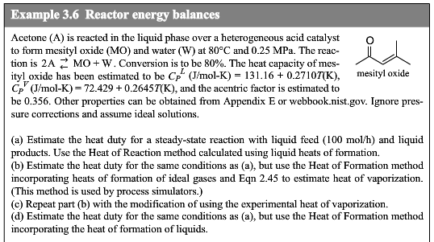


Slide 39
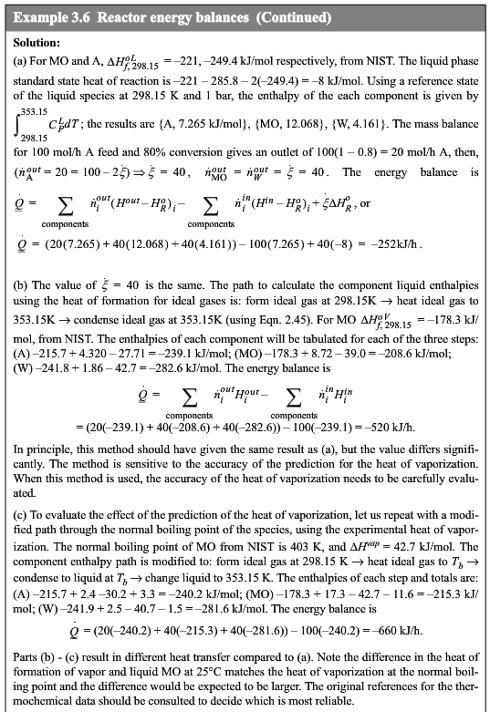

Slide 40
